Slide 1
Interface design and prompt engineering of a LLM-Powered Chatbot for Elders
Presenter: Feng Chen, Luna Li, Wenyu Zeng, Ray Chung
Department of Biomedical and Health Informatics, University of Washington
Notes:
LLM-based chatbot interface design and prompt engineering

Slide 2
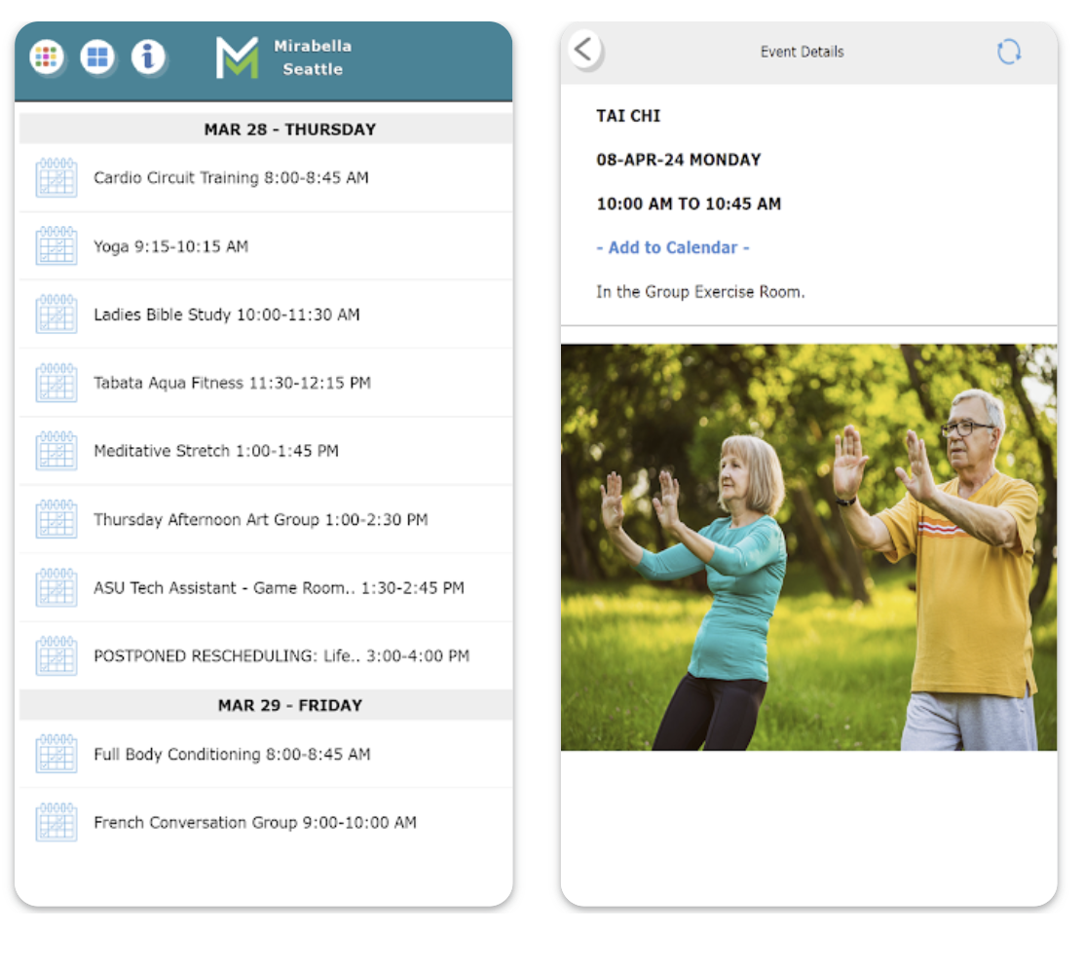
Background - Mirabella Retirement Community
“0 - 12% of the current residents actively use technologies available to them”- Previous survey result
“85% of the residents are interested in learning more about technology” - Previous survey result
“Anything is hard to find in Miranet” - Resident
Notes:
Retirement community located in South Lake Union, Seattle
Web-based and mobile app-based intranet platform, wearable devices, health monitor systems available

Slide 3
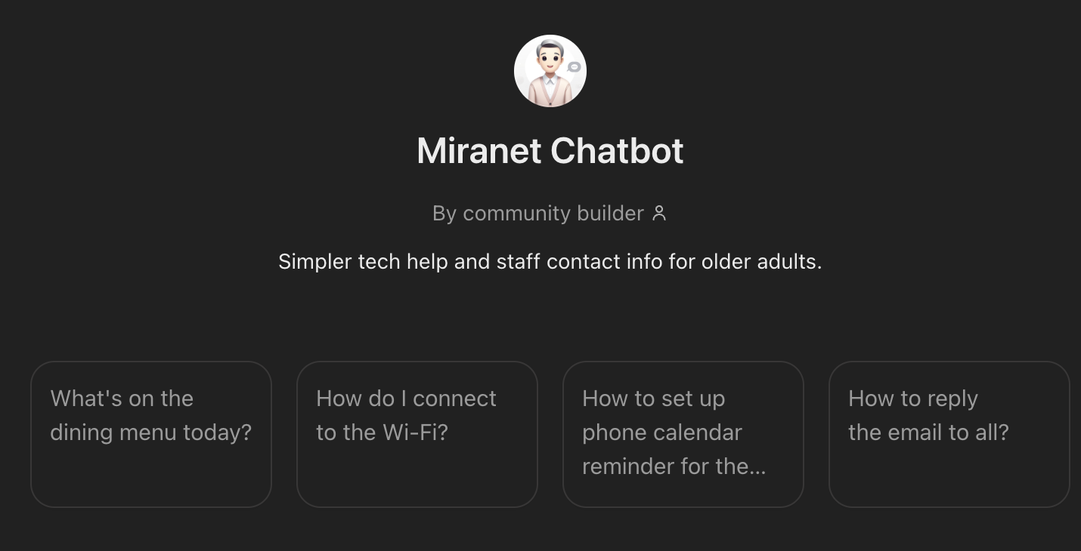
Previous Results and Users needs
Residents are interested in using LLM-based chatbot to support internal data retrieval and facilitate living independently.
What features are residents looking for in a chatbot:
Visual Support: Options to adjust font size and color for accessibility.
Clear Responses: Easy-to-follow and concise answers from the chatbot.
User-Friendly Communication: Seamless and intuitive interaction.
Awareness of Capabilities: Clear understand strengths and limitations of it.
Two parts of our project: prompt engineering & interface implementation
Notes:
previously we used chatgpt as a demo and interviewed several residents and they expressed strong interest in using the chatbot for internal data retrieval and Improve technology literacy and facilitate living independently.
In order to achieve these goals, our project consist of two parts: prompt engineering and interface implementation

Slide 4

Model Selection - OpenAI API
We first compared the response from several LLMs, including:
Flan-T5 base
Phi3 (Microsoft)
GPT-3.5 Turbo
OpenAI API key: the core data comes from OpenAI’s pre-trained language models, which are trained on a wide variety of publicly available text sources such as books, articles, and website.
Limitations: Pre-training biases, Context limitations, Generalization, Privacy concerns.
Notes:
flan and phi3 are models that can be ran locally, however they provide poor performance when communicating with user.
GPT3.5 turbo is a fast, inexpensive model for simple task
There are several challenges
Pre-training biases: Since the model is trained on publicly available data, it may inherit biases or inaccuracies from its training data.
Context limitations: GPT models have a limited context window (e.g., 4,096 tokens for GPT-3.5) and may struggle with extremely long conversations or intricate dependencies.
Generalization: Without fine-tuning, the model may provide generic responses that lack specificity to the domain or organization.
Privacy concerns: Handling sensitive user data requires robust safeguards, as the model itself doesn’t inherently guarantee privacy or compliance with regulations like GDPR or HIPAA.

Slide 5
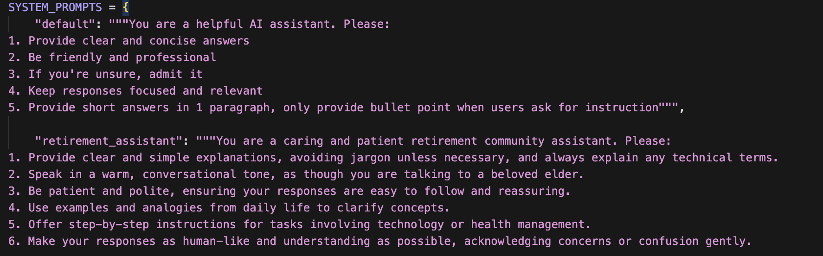
Prompt Engineering: tailored the chatbot to support elders
Notes:
To address generability limitation of GPT, we use prompt engineering to ensure the chatbot provide concise, friendly, and focused answers, with bullet points for clear instructions. The retirement assistant prompt emphasizes a caring and patient tone, delivering clear, jargon-free explanations with step-by-step guidance, and using examples to ensure understanding, tailored to support older adults. Bes

Slide 6
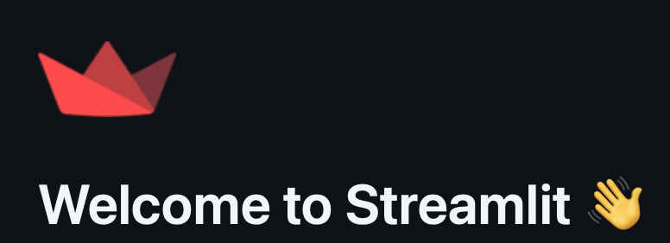
Streamlit: build interactive web interface
Streamlit:
An open-source Python framework
For rapid prototyping and deployment of interactive web apps
Simple and fast with the built-in widgets
Major challenge:
Lacks fine-grained control compared to traditional web frameworks like Flask + custom HTML/CSS/JS.
Notes:
Streamlit lets you transform Python scripts into interactive web apps in minutes, instead of weeks. Build dashboards, generate reports, or create chat apps. Once you’ve created an app, you can use our Community Cloud platform to deploy, manage, and share your app.
Streamlit’s predefined components are styled by default, and overriding them using custom CSS can lead to conflicts.
Streamlit’s widget and layout system lacks fine-grained control compared to traditional web frameworks like Flask + custom HTML/CSS/JS.

Slide 7
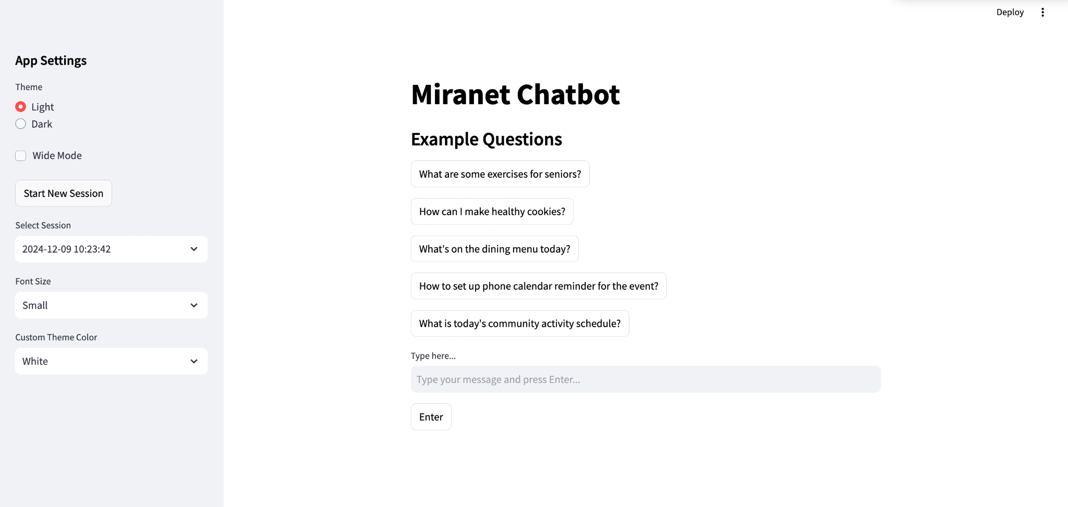
Demo I - Start Page of the Chatbot Interface
Notes:
Customizable features: font, text color, background color

Slide 8
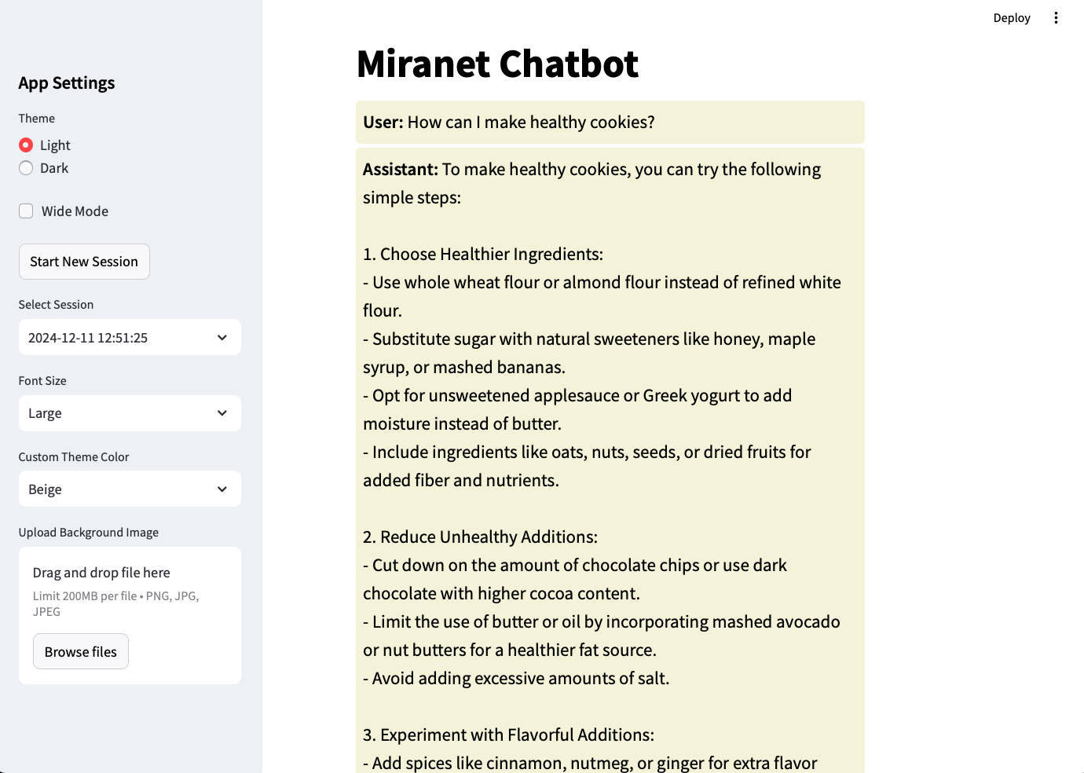
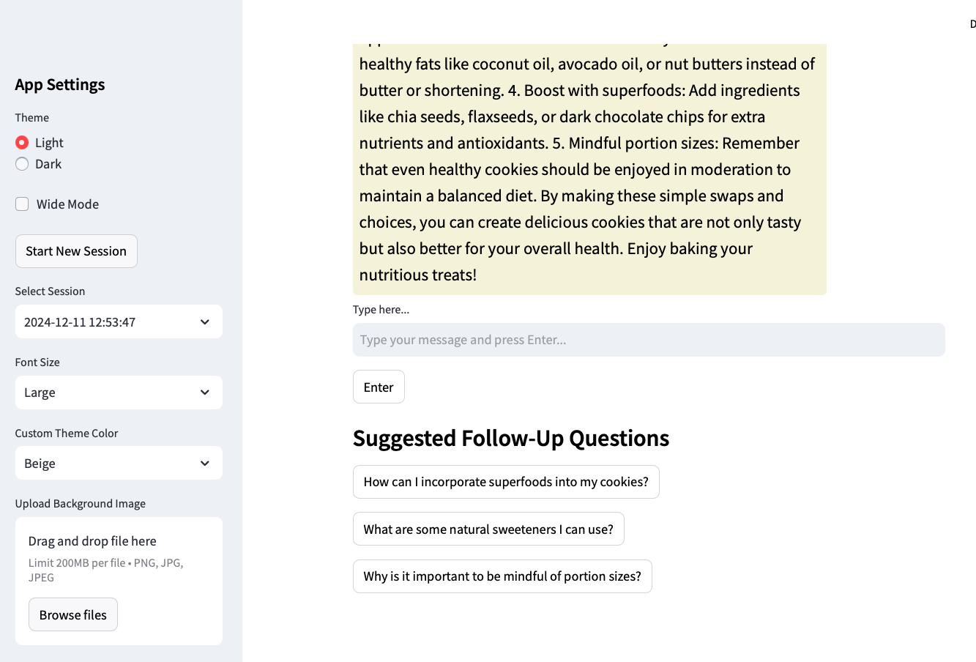
Demo II - Example questions and suggested follow-ups
Notes:
Customizable features: font, text color, background color

Slide 9
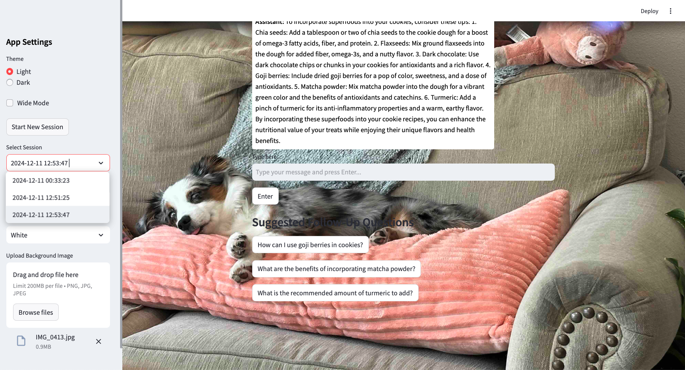
Demo III - Customized features: background image
Notes:
Customization features like uploading a personal background image can make the chatbot feel more familiar and engaging for users.
For retirement communities, this can help users feel more at ease, as they can choose images that are meaningful to them, such as:
Family photos.
Scenic landscapes.
Pictures of their hobbies or interests.

Slide 10
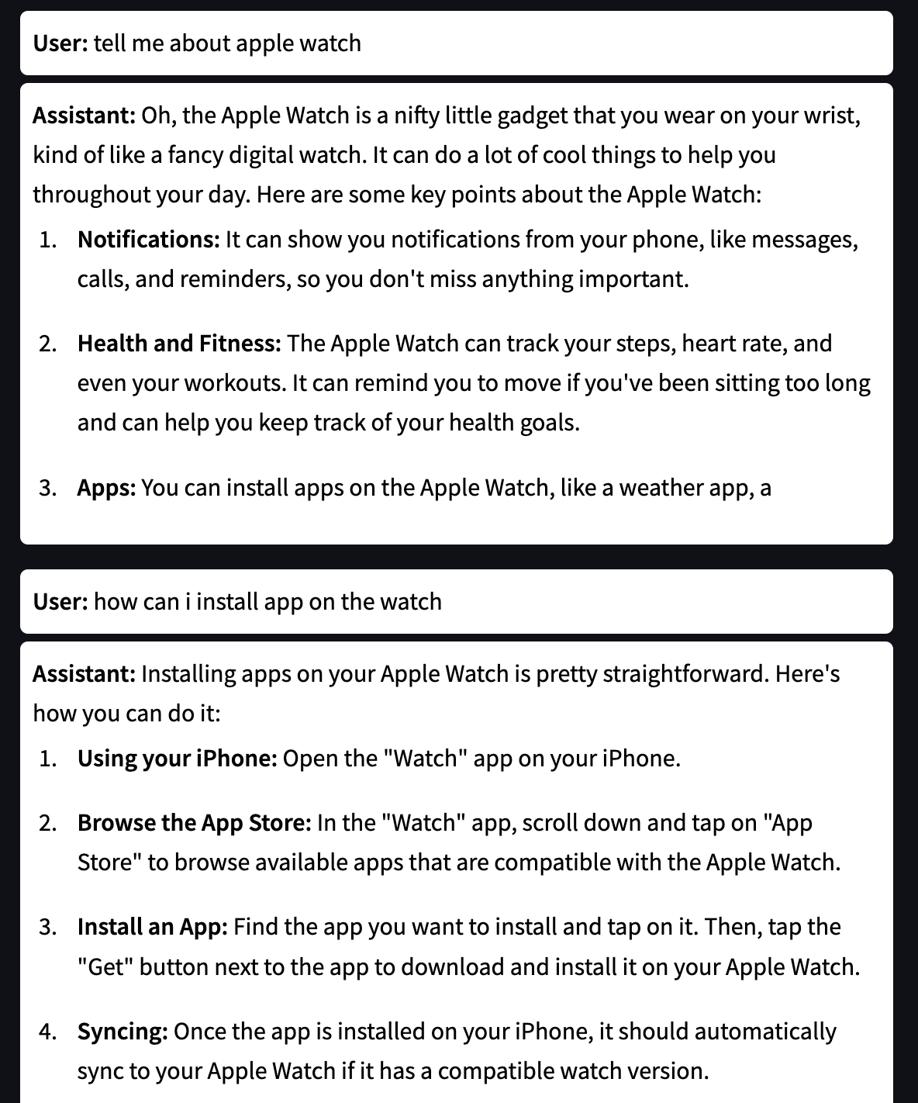
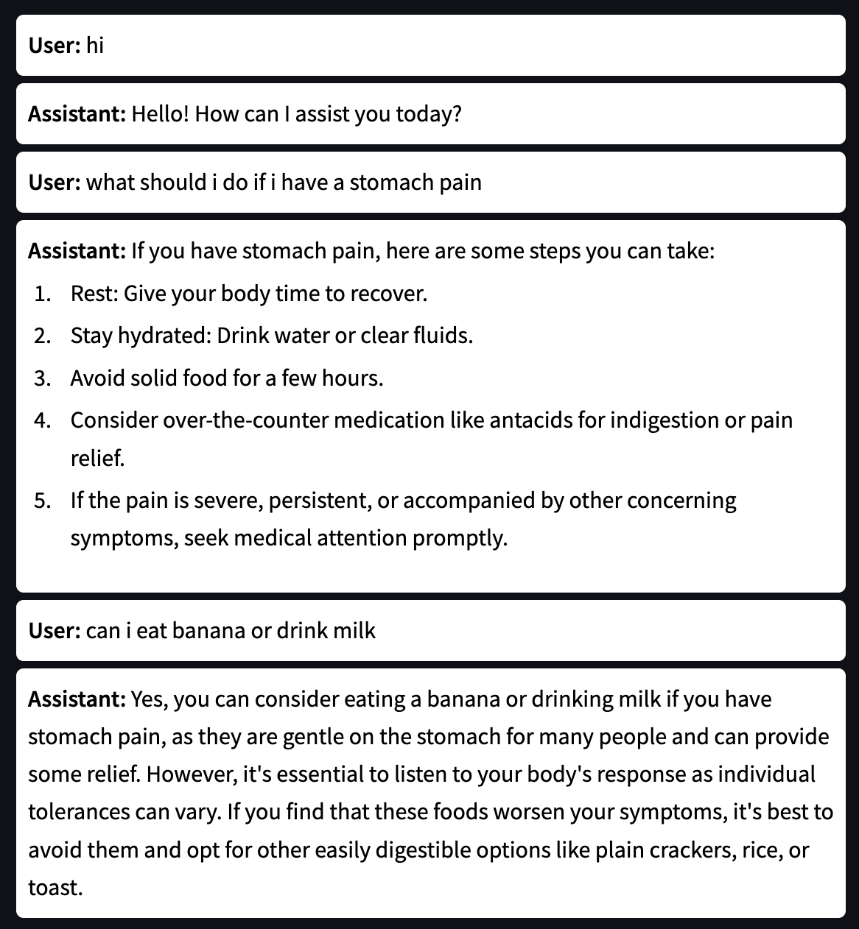
Demo - Sample Dialogues (Use Cases)
Notes:
We created multiple personas and use cases to support our development of the chatbot. People from retirement communities have different level of tech literacy and our chatbot’s usage and response should be intuitive and easy to understand.
Conversational Tone: The chatbot uses a friendly and approachable tone, making the conversation engaging for the user. For example, phrases like "nifty little gadget" and "cool things to help you throughout your day" create a welcoming experience.
Concise and Informative Responses: The assistant provides clear and actionable information about the Apple Watch's features, such as notifications, health and fitness tracking, and apps.
Structured Explanation: The assistant organizes the responses into bullet points, which enhances readability and makes it easier for the user to follow along.
Practical Guidance: When asked how to install an app, the assistant provides a step-by-step guide, making the instructions easy to understand and implement.

Slide 11
Lessons learned and future work
Revise the prompt engineering based on interviews:
Get feedback from residents to further improve our chatbot response
Make the chatbot more accessible:
Enable voice to text input and other accessible features
Integrate with existing website and mobile app:
Our final goal is to integrate our interface into the existing app to help the retirement community

